Slide 1
Detecting Trash on Beaches
By: Brady, Sam, Josh, Griffin, Ella

Slide 2
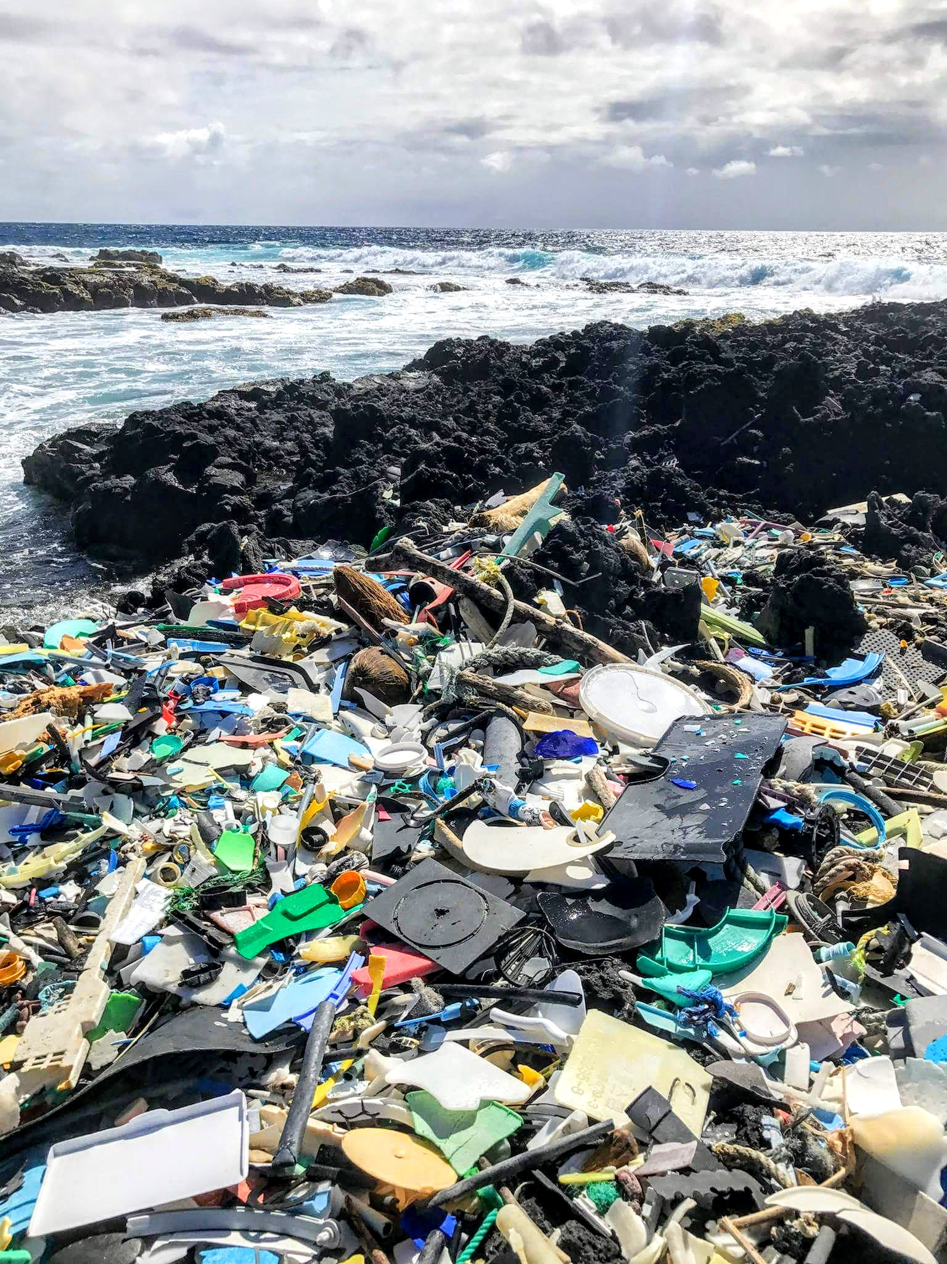
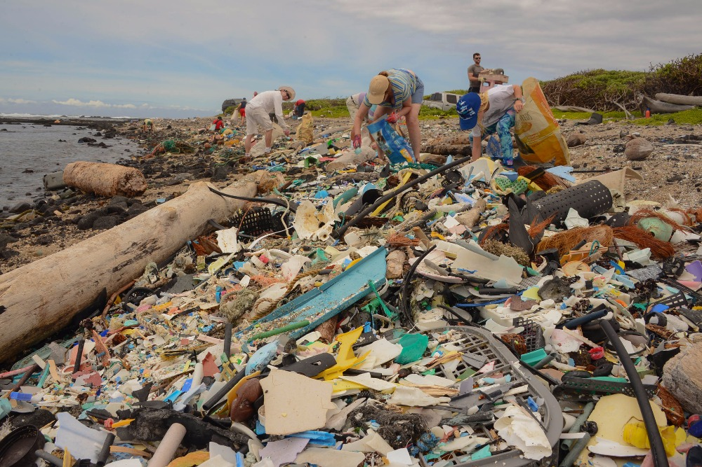
Trash Build-Up on Beaches
Kamilo Beach, Hawaii
Notes:
Every year, up to 14.3 million tons of plastic ends up in the world’s oceans. Much off which finds its way to beaches and shores, piling up and causing damage to the animals and plants who live there. So what’s happening to stop this? Beach cleanups are a great way to remove this trash and inform people on the effects of their actions.

Slide 3
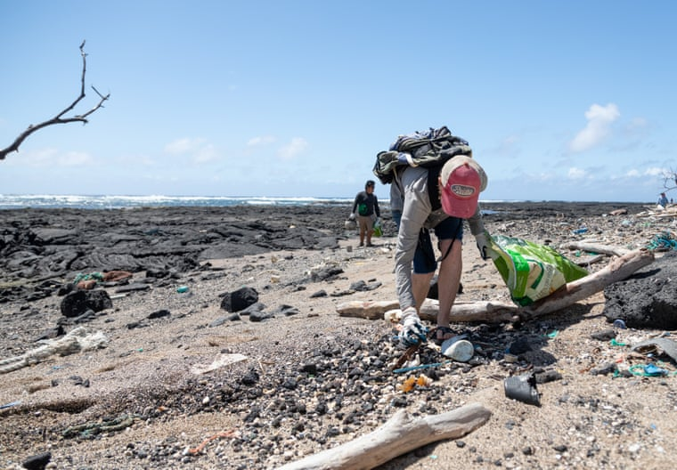
How Smart Monitoring Can Help
Location of beaches
that need cleaning
Trash cleaning crews
Server
Whether a beach
has trash on it
Diagram
Kamilo Beach, Hawaii

Slide 4
DEMONSTRATION

Slide 5
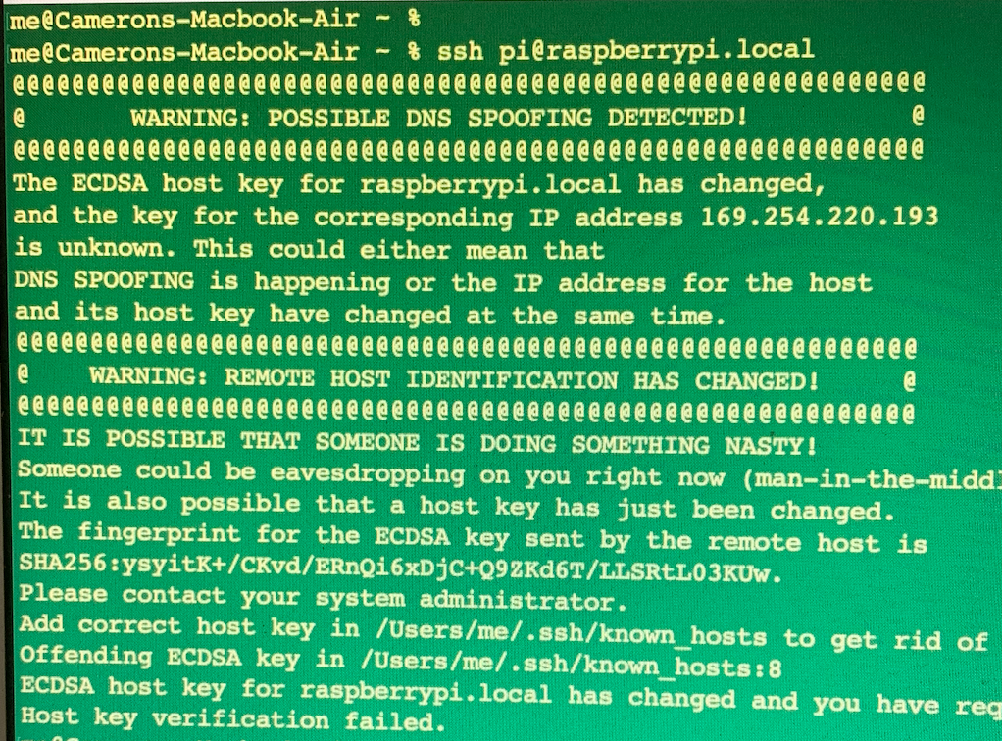
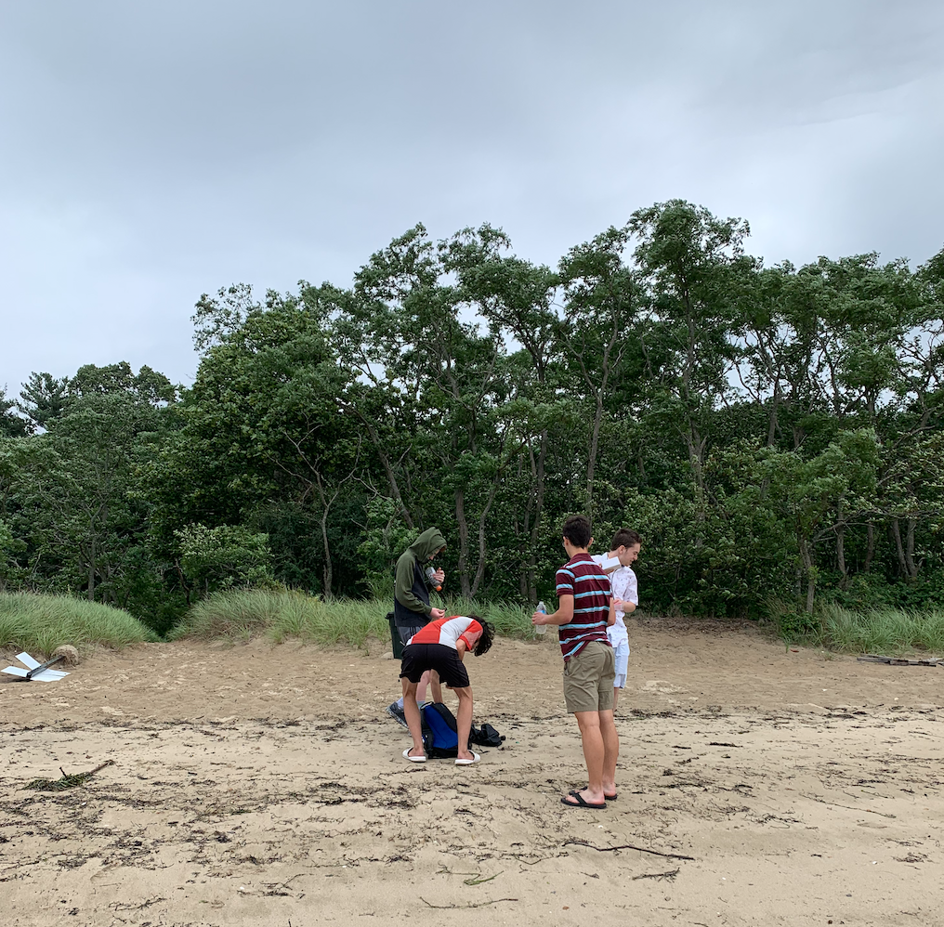
Process

Slide 6
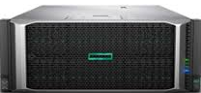

Impact at a Scale
server
Notes:
We’ve seen what one unit can do and how, so how do many more units work? Each unit would take an image each day, and analyze it on its own, only sending whether or not a location has trash (or how much) to a centralised server which could analyze and present data from potentially the whole world to people who could use it to coordinate cleaning efforts.

Slide 7
Cost of Implementation
Unit price:
$225 for Creation and Installation
$30* monthly maintenance
Infrastructure price:
Server: Upfront Cost of $2500
Monthly Maintenance of $20
*Cities and Towns will most likely have technicians who could maintain the units, dramatically decreasing the price for maintenance in those areas
Notes:
So, what’s the cost of implementing this? Well, for one unit we estimate that it takes $225, and would cost about $30 a month to maintain if a specialist was hired. To implement across the entire

Slide 8
Sources
https://paperswithcode.com/search?q_meta=&q_type=&q=trash
TRANSCEND MEDIA SERVICE » Welcome to Hawaii’s ‘Plastic Beach’, One of the World’s Dirtiest Places
How to Plan a Perfect Trip to Jamaica (inspirock.com)
What Does 1GB of Mobile Data Cost in Every Country? (visualcapitalist.com)
How Big Is the US Coastline, Really? (businessinsider.com)
Hawaii: Tours and Tickets - Tripadvisor
Ho‘okuleana: Kamilo Beach (totakeresponsibility.blogspot.com)

